Slide 1
Plugging into the future : An exploration of electricity consumption patterns using tableau
Agenda
Introduction
Data collection and presentation
Key metrics and dimensions
Visualization techniques in tableau
Pattern analysis and insights
Case study and applications
Practical implementation
Conclusion

Slide 2
Introduction
Electricity consumption patterns are critical for utilities , policy makers and consumers to optimize energy use , reduce costs, and support sustainable energy systems . Tableau, a leading data visualization platform , enables uses to create interactive dashboards and uncover actionable insights from energy data . By visualizing consumption trends , correlations with external factors , and anomalies , stake holders can make informed decisions for demand side management

Slide 3
Data collection and preparation
SOURCES : Gather data from reliable sources like the U.S.Energy information administration , smart meter data sets , or regional energy providers for eg ,datasets might include hourly , daily or monthly electricity consumption ,prizing or demographic data.
CLEANING : Ensure data consistency by handling missing values , standardizing units and aligning time periods.
INTEGRATION : Combine data sets , such as electricity usage with weather or population data, to enable multivariable analysis.

Slide 4
Key metrics and dimensions
CONSUMPTION METRICS : Total usage , per capita consumption , peak demand , and average monthly usage.
TEMPORAL DIMENSIONS : Hourly , daily , weekly , or yearly trends to identity seasonal or time-of-day patterns.
GEOGRAPHIC DIMENSIONS : Regional or location-based consumption.
DEMOGRAPHIC FACTORS : Household size , income levels , or building types.
EXTERNAL FACTORS : Weather , economic indicators , policy changes.

Slide 5
Visualization techniques in tableau
TIME-SERIES LINE CHARTS : Plot consumption over time to identity trends,such as seasonal peaks in summer due to air conditioning or reduced winter usage for organizations with natural gas heating.
GEOGRAPHIC MAPS : Visualize regional consumption patterns , like higher usage in densely populated areas.

Slide 6
Pattern analysis and insights
SEASONAL TRENDS : Higher electricity usage in summer due to cooling needs , as seen in Dubai’s residential data where 43% of household with cooling including peaked at midnight.
BEHAVIORAL INSIGHTS : Identify occupant behaviors , like higher daytime consumption in households with remote workers.
EFFICIENCY OPPORTUNITIES : Detect anamolies , such as unexpected winter consumption increases , which may indicate equipment issues.

Slide 7
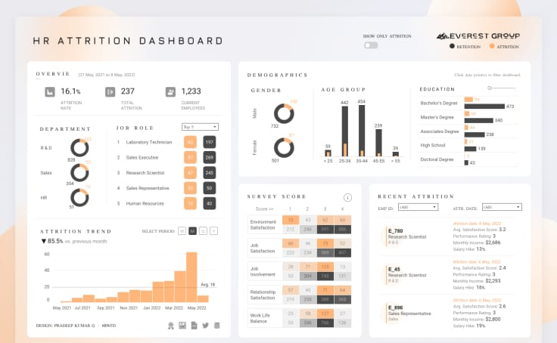
graphs
Using tableau

Slide 8
Case studies and applications
RESIDENTIAL ANALYSIS : A tableau dashboards analyzed electricity and gas consumption by dwelling type , revealing trends like hogher
COMERCIAL SECTOR : Companies like the north face used tableau to monitor real time energy data, savings
Renewable energy : tableau enabled enterprise- scale analysis for australias origin energy.

Slide 9
Practical implementation
IMPORT DATA : Load CSV/Excel files from sources like EIA or smart meters
CREATE VISUALIZATION :
Use line charts for temporal trends.
Use maps for geographic insights.
Add filters for interactivity
BUILD A DASHBOARD : combine visualizations into a single view , enebling users to explore metrics like per capita usage or peak demand

Slide 10
Conclusion
Tableau empowers users to “plug into the future” by transforming raw electricity consumption data into actionable insights.by visualizing temporal , geographic , and demographic patterns it supports energy efficiency , cost savings , and sustainability goals . From identifying peak demand in Dubai to forecasting renewable energy needs in Australia , tableau flexibility makes it a cornerstone for modern energy

